Slide 1

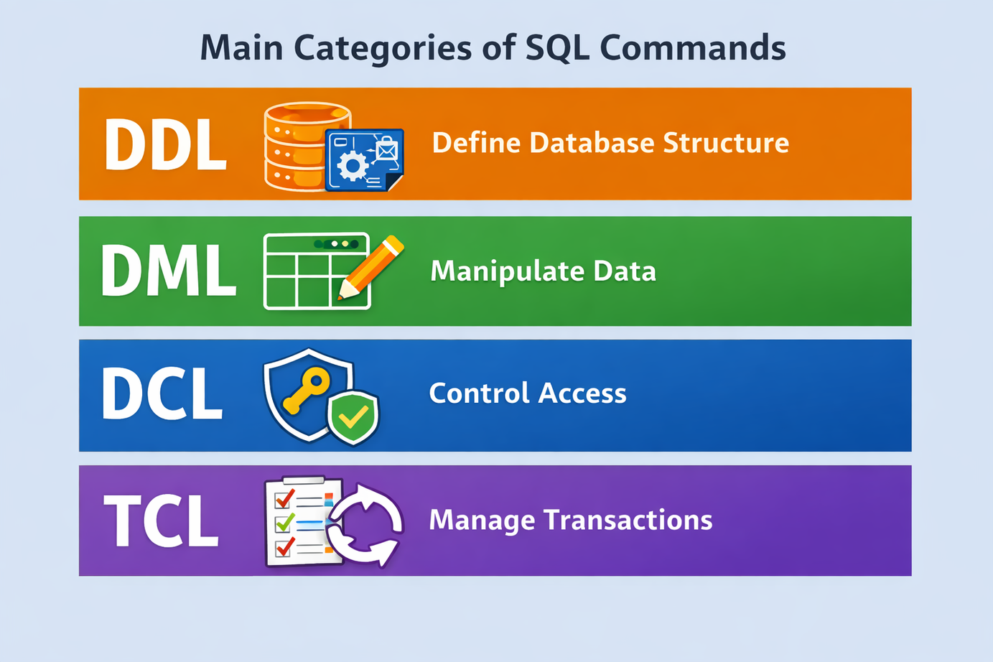
INTRODUCTION TO
SQL COMMANDS

Slide 2

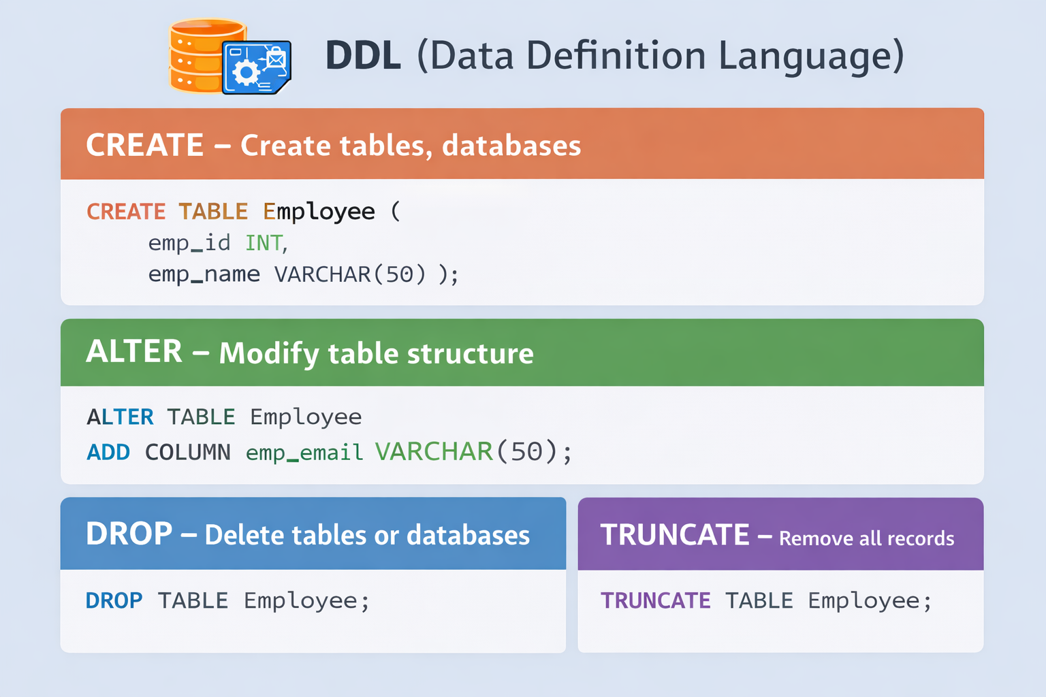
SQL COMMANDS OVERVIEW
DDL (Data Definition Language):
Purpose:
Used to create, modify, and delete database objects
Common DDL Commands:
CREATE – Create tables, databases
ALTER – Modify table structure
DROP – Delete tables or databases
TRUNCATE – removes all records quickly and
cannot be rolled back
2M
82%

Slide 3
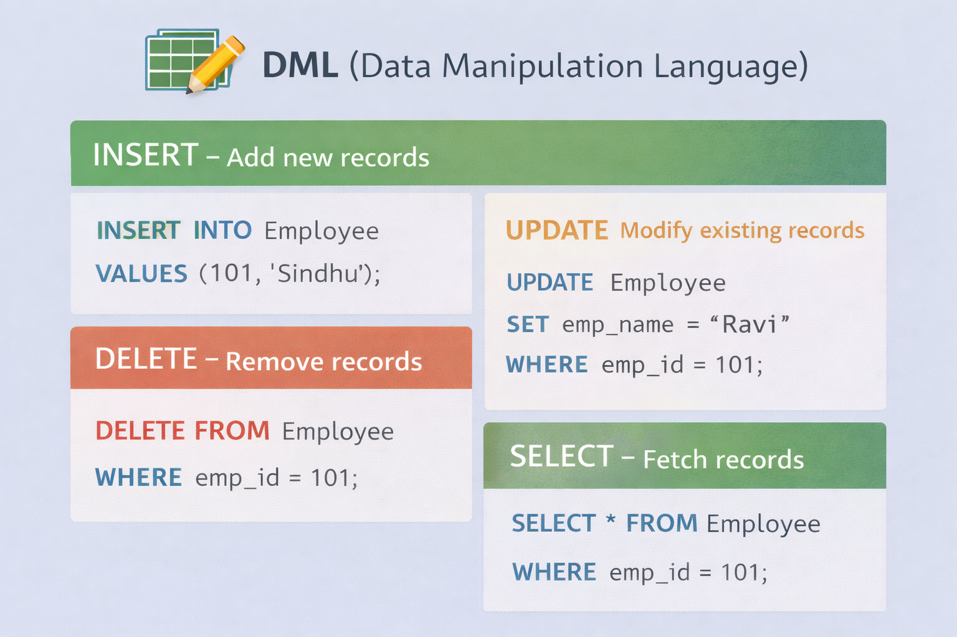
SQL COMMANDS OVERVIEW
DML (Data Manipulation Language):
Purpose:
Used to insert, update, delete, and retrieve data
Common DML Commands:
INSERT – Add new records
UPDATE – Modify existing records
DELETE – Remove records
SELECT – Fetch data
2M
82%

Slide 4
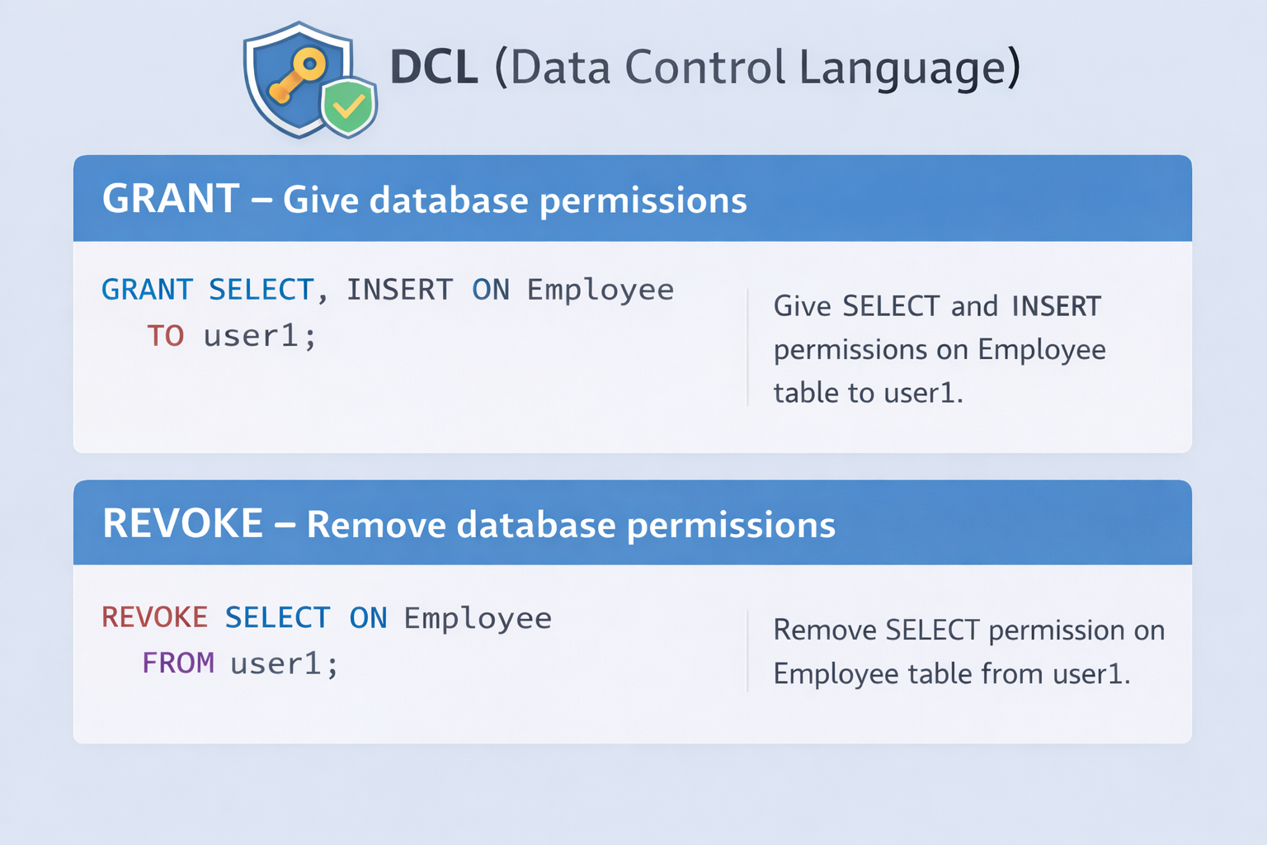
SQL COMMANDS OVERVIEW
DCL (Data Control Language):
Purpose:
Controls database access
Common DCL Commands:
GRANT – Give permissions
REVOKE – Remove permissions
2M
82%

Slide 5
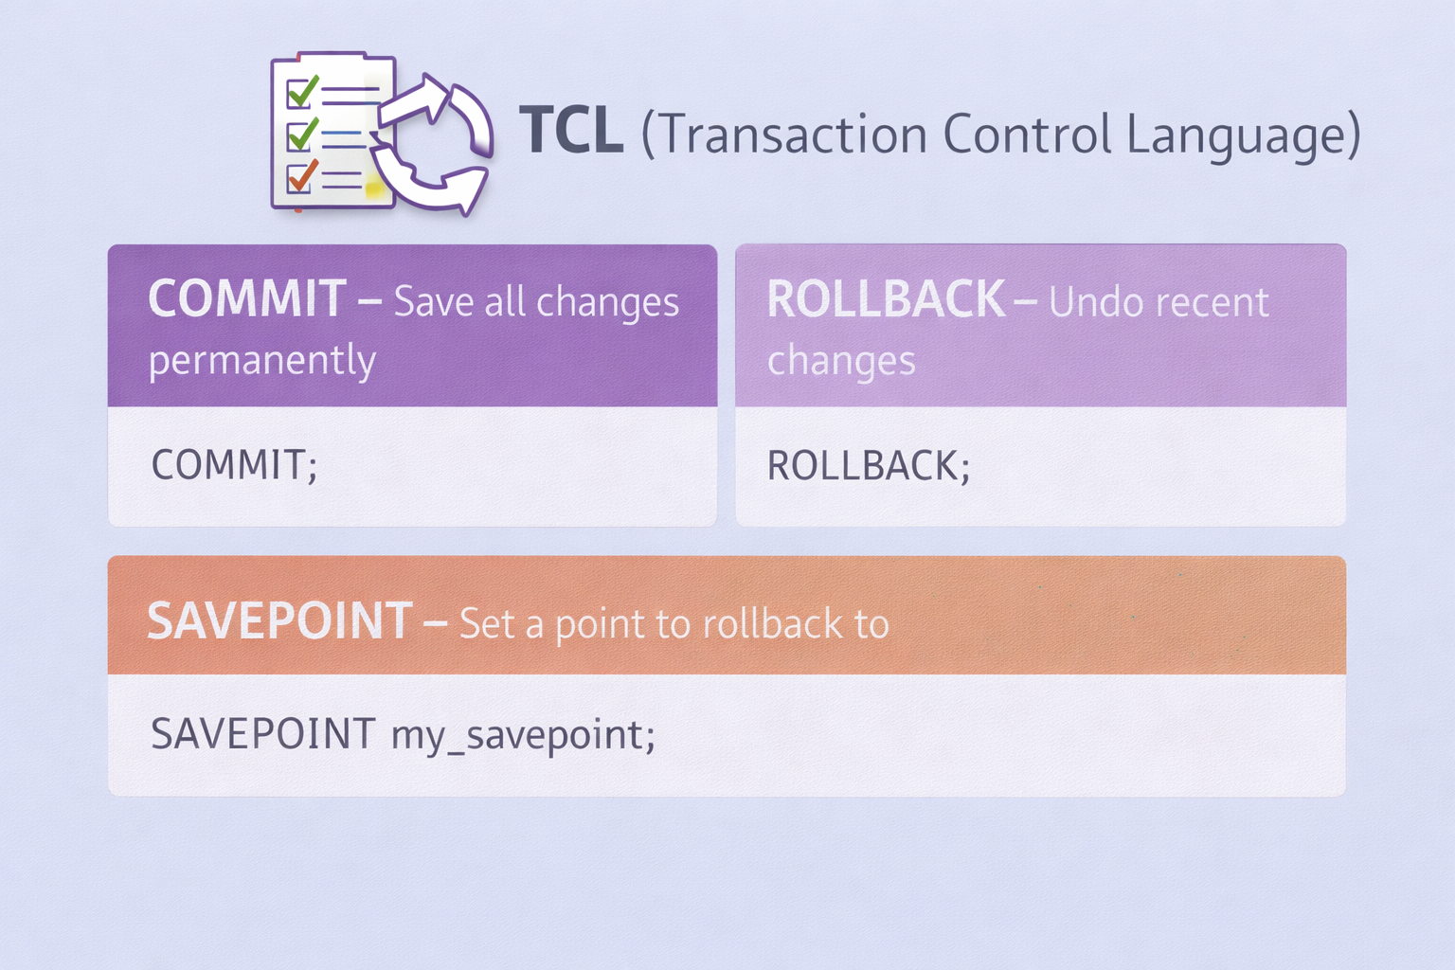
SQL COMMANDS OVERVIEW
TCL (Transaction Control Language):
Purpose:
Used to Manage transactions
Common DDL Commands:
COMMIT – Save changes
ROLLBACK – Undo changes
SAVEPOINT – Mark a point
2M
82%

Slide 6
SQL Constraints
Definition:
SQL Constraints are rules applied to table columns to ensure data accuracy, integrity, and consistency in a database.
Types of Constraints:
NOT NULL – Prevents NULL values
UNIQUE – Ensures all values are different
PRIMARY KEY – Uniquely identifies each record
FOREIGN KEY – Links one table to another
CHECK – Allows only valid values
DEFAULT – Assigns a default value if none is given
Example:
emp_id INT PRIMARY KEY,
age INT CHECK (age >= 18)
2M
82%

Slide 7

THANK YOU
VISIT US

